Slide 1
SQL – More advanced queries
Nested sub queries
Aggregate functions
Views

Slide 2
Subqueries
A parenthesized SELECT-FROM-WHERE statement (subquery) can be used as a value in a number of places, including FROM and WHERE clauses.
Example: in place of a relation in the WHERE clause, we can place another query, and then query its result.

Slide 3
Subqueries – returning one tuple
If a subquery is guaranteed to produce one tuple, then the subquery can be used as a value.
Usually, the tuple has one component.
A run-time error occurs if there is no tuple or more than one tuple.

Slide 4
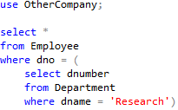
Example
Employees who work in the Research department

Slide 5
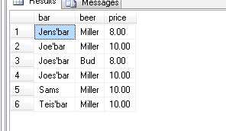
Example
From Sells(bar, beer, price), find the bars that serve Miller for the same price Joe charges for Bud (‘Miller’ and ‘Bud’ are American beer brands).
Two queries would surely work:
Find the price Joe charges for Bud.
Find the bars that serve Miller at that price.

Slide 6

Query + Subquery Solution find the bars that serve Miller for the same price Joe charges for Bud
SELECT bar
FROM Sells
WHERE beer = ‘Miller’ AND
price = (SELECT price
FROM Sells
WHERE bar = ‘Joe’’s Bar’
AND beer = ‘Bud’);
The price at
which Joe
sells Bud

Slide 7
The IN Operator
<tuple> IN <relation> is true if and only if the tuple is a member of the relation.
<tuple> NOT IN <relation> means the opposite.
IN-expressions can appear in WHERE clauses.
The <relation> is often a subquery.

Slide 8

The IN Operator
Simple use of IN operator:

Slide 9
IN Operator example
select * from project where pnumber in (
select distinct pno from works_on where hours = 10
)

Slide 10
Find projects that has a person named Smith working on them
select pnumber, pname
from Project
where pnumber in
(select pno
from Works_on, Employee
where essn= ssn
and lname = 'Smith')

Slide 11
The Exists Operator
EXISTS( <relation> ) is true if and only if the <relation> is not empty
Being a boolean-valued operator, EXISTS can appear in WHERE clauses

Slide 12


Example Query with EXISTS

Slide 13
Example Query with EXISTS
For each employee tuple evaluate the nested query
select e.fname, e.lname
from employee e
where exists ( select *
from dependent
where e.ssn = essn and e.sex = sex
and e.fname = dependent_name)

Slide 14
ALL
All returns true if the value (salary) is greater
than all the values in the resultset of the sub select
select lname, fname
from employee
where salary > all ( select salary
from employee
where dno = 4)

Slide 15
Outer join
select fname, lname, dname as mgrOf
from (employee left outer join department on ssn = mgr_ssn)
(‘outer’, may be omitted on SQL Server. Left / right / full)
John Smith NULL
FrankLin Wong Research
Joyce English NULL
Ramesh Narayalan NULL
James Borg Headquarters
Jennifer Wallace Administration
Ahmad Jabbar NULL
Alicia Zelaya NULL

Slide 16
Select
select < attribute and function list>
from < tablelist>
[where < condition>]
[group by <grouping attributelist>
[Having <group condition>]]
[Order by < attributelist>]

Slide 17
Order by
select *
from Employee
order by bdate
select *
from Employee
order by bdate desc

Slide 18
Group by
select dno, count(*) as numEmployees
from Employee
group by dno

Slide 19


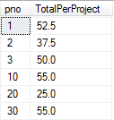
Group by and sum()

Slide 20
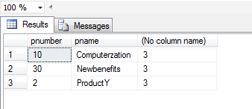
Group by - having
/*query q26*/
/* for each project on which more than two employees work, retrieve the */
/* project number, the project name and the number of employees who work */
/* on the project */
select pnumber, pname, count(*)
from project, works_on
where pnumber = pno
group by pnumber, pname
having count(*) > 2

Slide 21
Views in SQL
A view is a “virtual” table that is derived from other tables
Allows for limited update operations (since the table may not physically be stored)
Allows full query operations
A convenience for expressing certain operations

Slide 22
Specification of Views
SQL command: CREATE VIEW
a view (table) name
a possible list of attribute names (for example, when arithmetic operations are specified or when we want the names to be different from the attributes in the base relations)
a query to specify the table contents

Slide 23
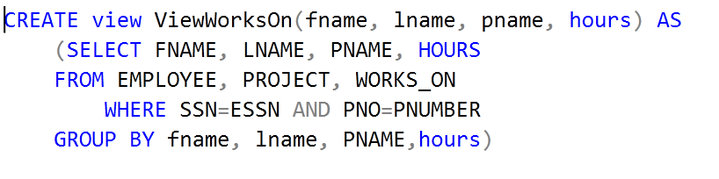
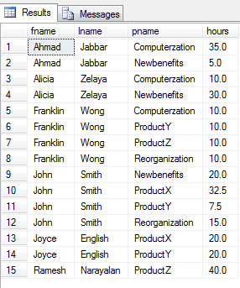


Slide 24
Using a View
We can specify SQL queries on a newly created view:
SELECT FNAME, LNAME
FROM ViewWorksOn
WHERE PNAME=‘ProductX’;
When no longer needed, a view can be dropped:
DROP VIEW ViewWorksOn;

Slide 25
View Update
Don’t!
In general only use views for querying

Slide 26
Intended Learning Outcomes (ILOs)
Can do SQL queries and updates on a database (from module 02).
Can use nested SELECT in queries.
Can use GROUP BY and HAVING in queries.
Can use aggregate functions in queries.
Can create and use views

Slide 27
Exercises
Try out some of the queries on these slides.
Finish the previous exercises, if unfinished.
If idle: make a small database and try out the stuff we have learned.

